Slide 1
Climate and Vegetation (continued)
Ocean Currents
  Influence climate
  Japan current (“Kuroshio”)
    Flows Northward along southern and southeastern coasts of Japanese islands
    Warms the land
  Kuril current (“Oyashio”)
    Flows southwest from Bering sea along Japan’s northern islands
    Brings harsh, cold winters
  Typhoons
    Violent storms that form in Pacific and blow across coastal East Asia
    Can cause severe damage

Slide 2
Chapter 27
Population Patterns &
History and Governments

Slide 3
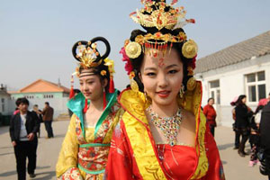
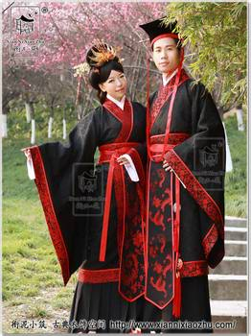
Population Patterns
Human Characteristics
  1.5 billion people
    25 % of world population
    Major ethnic groups
      Chinese, Tibetan, Korean, Japanese, and Mongolian
China
  “people of the middle kingdom”
  Major ethnic group: Han
  Other ethnic groups (8%)
    Belong to 55 different groups
      Most live in Western and Northern China
        Ex. Tibetans – ruled by Chinese since 1950

Slide 4
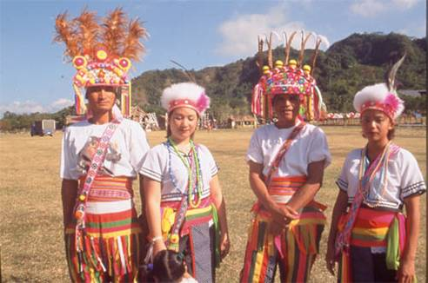
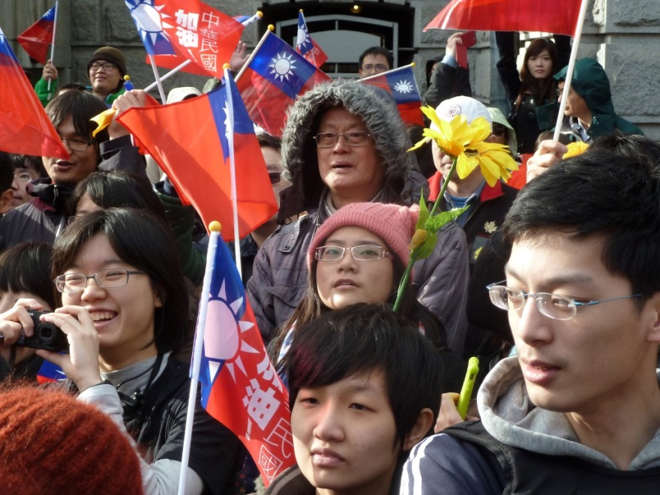
Population Patterns (cont.)
Taiwan
  Most Taiwanese descended from Chinese who came hundreds of years ago
  15% came after Communist takeover of China
  Taiwan’s original inhabitants
    ABORIGINES

Slide 5
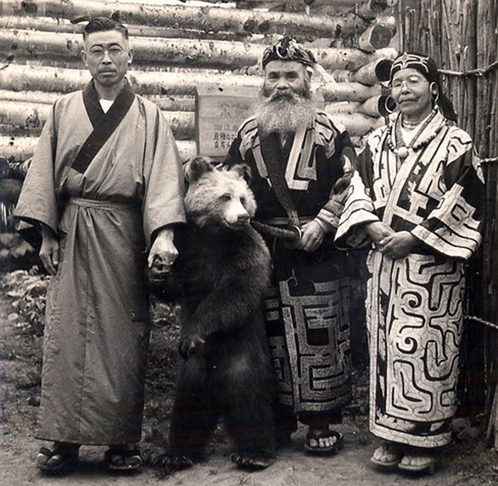
Population Patterns (cont.)
Japan, Korea, & Mongolia
  Japan
    Ethnically HOMOGENOUS
      99% Japanese
    Native inhabitants: AINU
  Korea
    Also ethnically homogenous
  Mongolia
    Mostly ethnic Mongolians

Slide 6
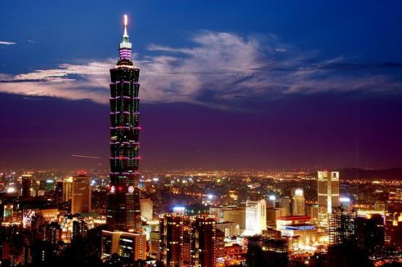
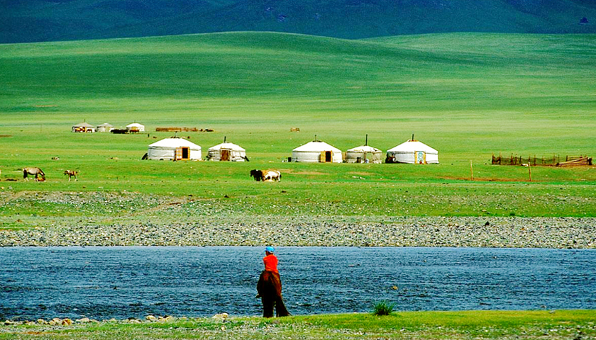
Population Patterns (cont.)
Where East Asians Live
  Population distributed unevenly
  Most East Asians settle in coastal or fertile river areas
    Some of these most densely populated on Earth
China
  90% live on 1/6 of land
  Rugged Western provinces
    Xinjiang
    Inner Mongolia
  Taiwan
    Space limited
    Live in cities like TAIPEI or close to coast

Slide 7
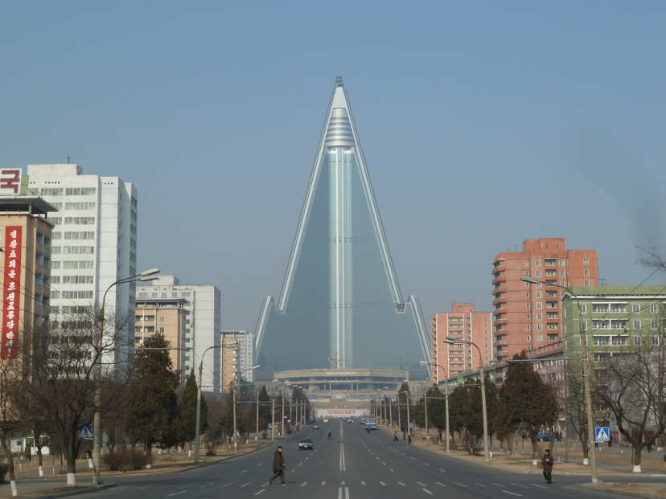
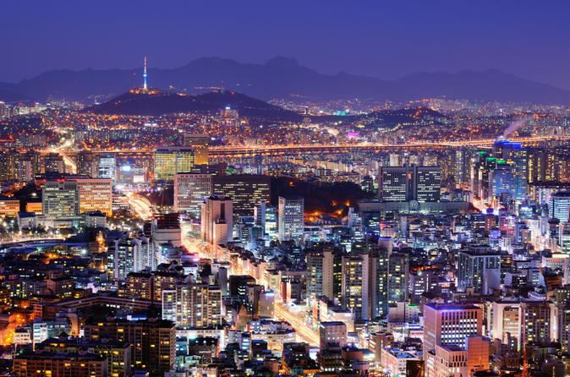
Population Patterns (cont.)
North & South Korea
  Most live in coastal plains that wrap around Peninsula
  2/3 live in growing cities like SEOUL and PYONGYANG
Japan
  Limited area for large population
  Mountains in center
  78% of 125 million people- urban coastal areas
      TOKYO CORRIDOR
        Series of cities crowded together on main island of HONSHU
        TOKYO – world’s most populous urban area

Slide 8
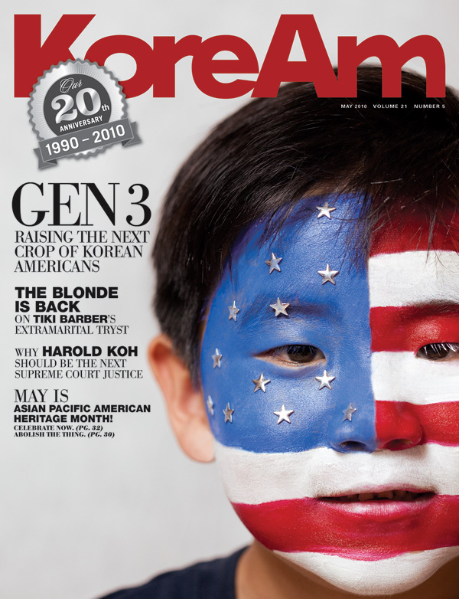
Population Patterns (cont.)
Japan’s Urban Lifestyle
  Neon signs, skyscrapers, people living in apartments
  Efficient transportation system: bullet train
Migration
  China
    Most Chinese still live and work on farms
      Many now moving to cities
  South Korea
    People fled North Korea mid-1900s

Slide 9
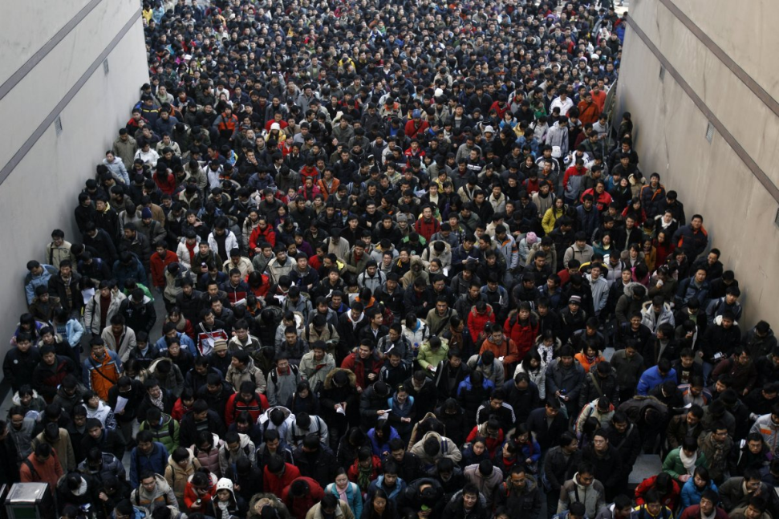
Population Patterns (cont.)
Challenges to Growth
  Urbanization has led to overcrowding in cities
    Chinese solutions: build rural agricultural towns in remote areas
  Unchecked population growth
    1979: one-child policy begins (recently ended)

Slide 10
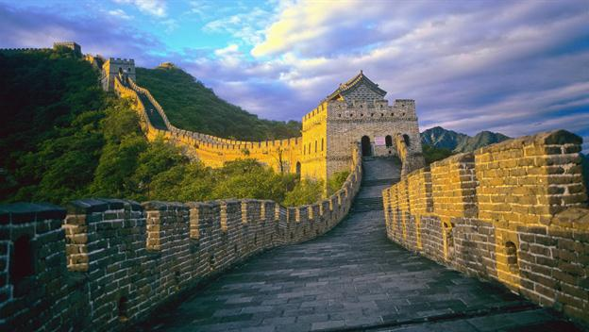
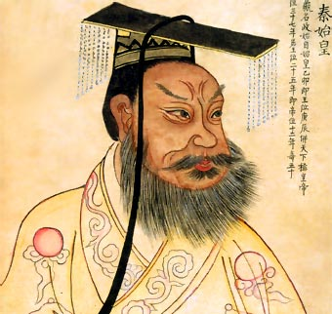
History and Government
Ancient East Asia
  Home to some of the world’s oldest civilizations
  China was CULTURAL HEARTH for neighbors
    A center from which ideas and practices helped shape East Asia’s cultures

Slide 11
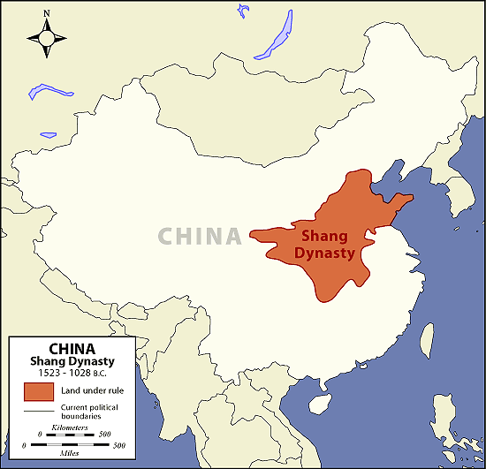
History and Governments (cont.)
China’s Dynasties
  Chinese culture started 5,000 years ago in Wei Valley (Yellow River area)
  Records first kept under Shang DYNASTY, or ruling family
    Took power 1600 B. C. in North China Plain
    Goals of Shang and later dynasties
      Put down rebellions
      Prevent incursions of Central Asian nomads
      Fix China following natural disasters
  When dynasty fell it had lost the “mandate of heaven”
    i. e. - “God” wanted this

Slide 12
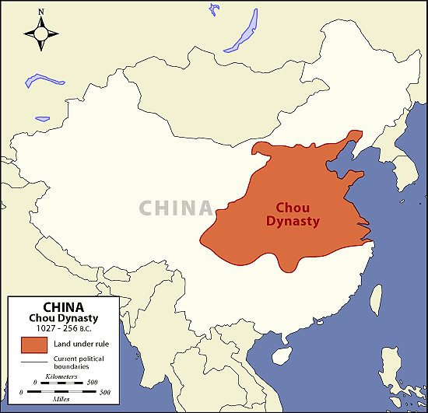
History and Governments (cont.)
Zhou Dynasty
  Ruled for 900 years
  Contributions
    Culture and trade spread
    Development of iron tools
    Life of CONFUCIUS
      Chinese philosopher
        System of thought based on discipline and moral conduct
    Life of LAOZI
      Founder of DAOISM
        Philosophy of simplicity and harmony with nature

Slide 13
History and Governments (cont.)
200s B.C.
  Qin Shi Huang Di unites China
    Builds first section of Great Wall
Later dynasties
  Han, Tang
    Chinese culture spreads to all of E. Asia
  Ming
    Zheng He sails to E. Africa
  Qing
    Mid-1600s to early 1900s

Slide 14
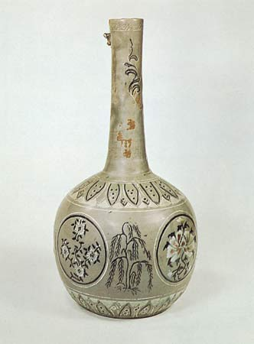
History and Governments (cont.)
Korea
  1200 B. C.
    Chinese settlers bring culture to Koreans
      Buddhism spread a bit later and becomes major Korean religion
  Later centuries
    Silla and Koryo dynasties unite Peninsula
    A.D. 1300
      China takes Korea
        Confucianism spread – becomes model for Korean government, education, and family life

Slide 15
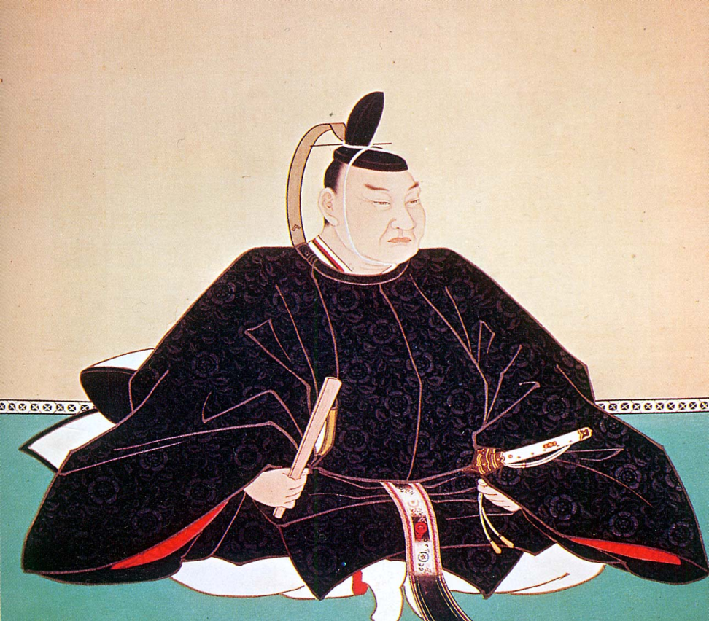
History and Governments (cont.)
Early Japan
  Korea linked Chinese and Japanese culture
  Once ruled buy CLANS
    Family groups
  Yoritomo Minamoto became Japanese first SHOGUN
    Military ruler
    SAMURAI, or professional soldiers, supported him

Slide 16
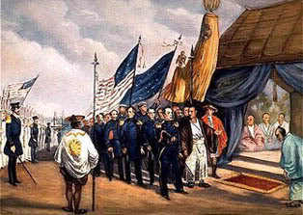
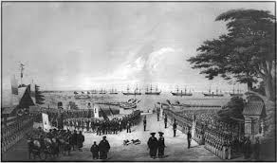
History and Governments (cont.)
Contact with West
  1600s
    Europeans trade with China
      Limited trade
        Port of GUANGZHOU opened
          Euros want more trade!
  Europeans use warships to take over SPHERES OF INFLUENCE in China
    Areas in which they had special trading rights
  1854 – U. S. Naval officer Commodore Perry forces Japan to open up trade
    End of Japanese isolation

Slide 17
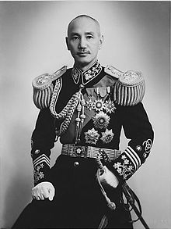
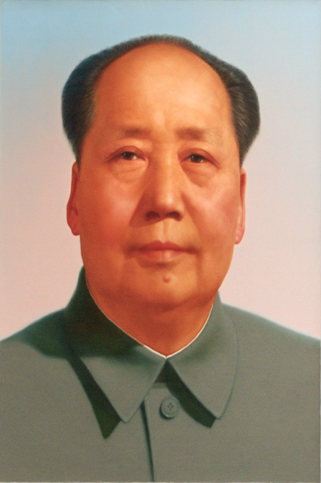
History and Governments (cont.)
Revolutionary China
  1911
    Revolution by Sun Yat-sen
      End rule of emperors
  1927
    Military leader Chiang Kai-shek forms Nationalist government
    Fights civil war against Chinese Communists led by Mao Zedong
      Communists win and set up People’s Republic of China (PRC) in 1949
      Nationalist government flees to Taiwan
        Set up government called Republic of China

Slide 18
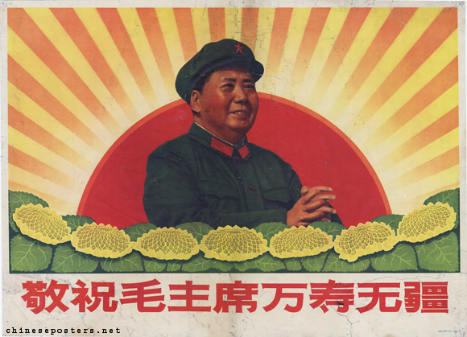
History and Governments (cont.)
Communist China
  Great Leap Forward
    1950s
    Millions of Chinese starve to death
  Cultural Revolution (late 60s)
    Mao afraid of losing power
      Starts “cult of personality”
        Young followers (“Red Guards”) go around killing people

Slide 19
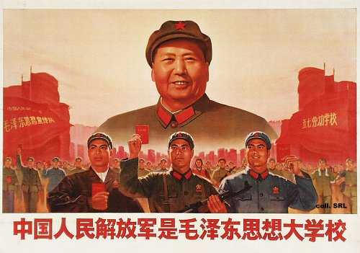
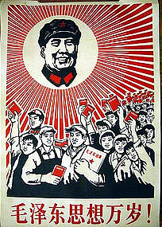
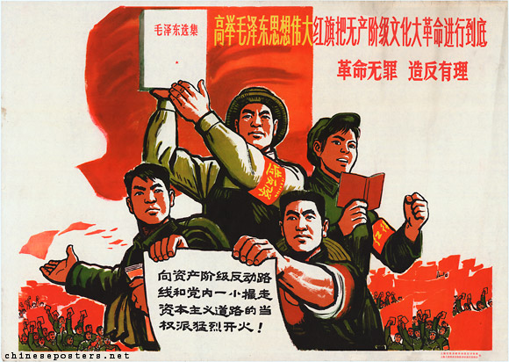
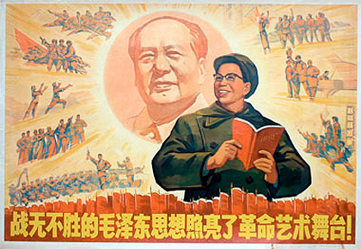

Slide 20
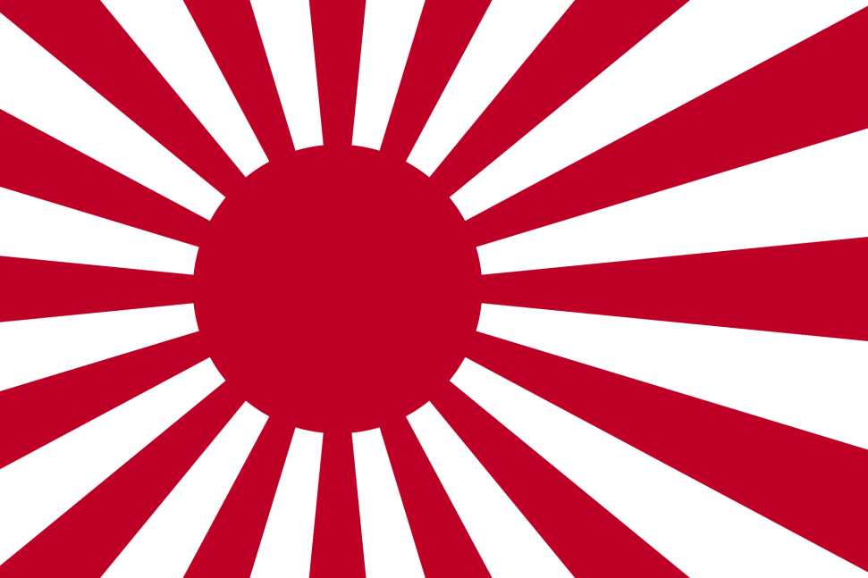
History & Government (cont.)
Japan’s Transformation
  1890-1940s
    Japan industrializes
    Becomes “modern”
    Creates huge Empire that takes over much of East Asia in 1930s/1940s
    Bombs America
      WWII
        Japan loses
          Becomes democracy after war

Slide 21
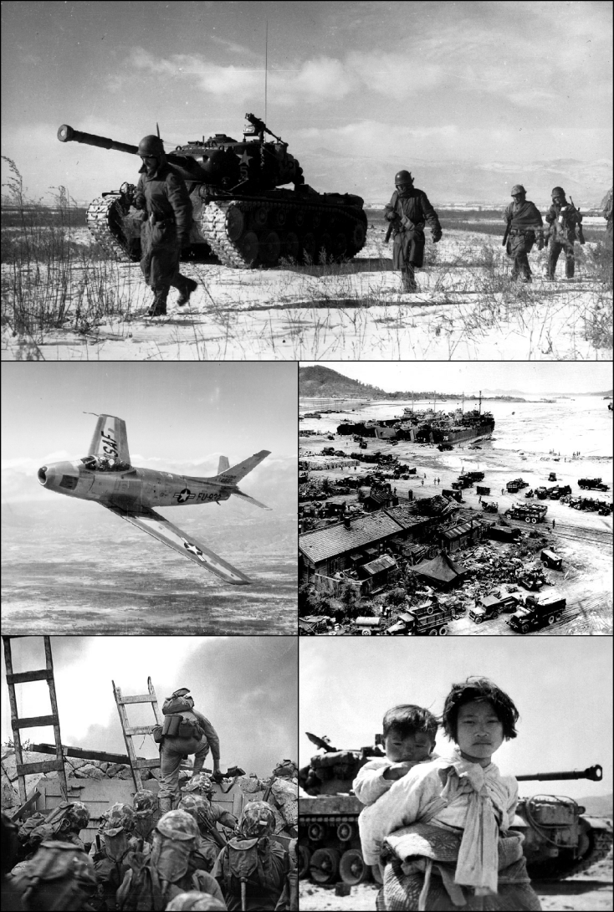
History & Governments (cont.)
Divided Korea
  After WWII
    Korea divided
      Communist North
      Capitalist South
    North invades South
      United States + United Nations comes to help
        Stalemate at 38th parallel (1953)
          No peace treaty ever signed
  North Korea still a dictatorship
  South Korea a democracy
Mongolia
  Communist until fall of Soviet Union
  Now a market economy

